Slide 1
Trade Remedy Response and Circumvention
Alan V. Deardorff
University of Michigan
For presentation at
Seoul International Forum on Trade Remedies
July 3, 2018

Slide 2
Trade Remedies
Anti-dumping duties (ADD)
On “dumped imports”
Target firms and/or countries
Countervailing duties (CVD)
On subsidized imports
Target firms and/or countries
Safeguard tariffs
On injurious imports
Apply to imports from all sources

Slide 3
Trade Remedies
Economists’ views:
Dumping is not harmful
Except very rarely, when “predatory”
Subsidized imports do distort markets if not justified by market failure
CVDs may be beneficial for world
But they harm the importer, who would benefit from subsidized imports
Injurious imports may justify temporary protection as 2nd best relief

Slide 4
Trade Remedies
My focus here: Market responses to anti-dumping laws and duties
Threat of AD
Process of AD
Price responses to AD
Circumvention of AD

Slide 5
Threat of Anti-dumping
“Chilling effect” on trade
Exporters who fear ADD will
Charge higher prices if able, to avoid ADD
Not export at all
Effect of the Anti-dumping Law is to
Reduce trade
Raise price in importing countries, just like a tariff
But without the tariff revenue

Slide 6
Process of Anti-dumping
Collusion
In US at least, after AD case is filed
Foreign exporters and domestic firms are encouraged to consult and try to resolve the case by agreement
That agreement is to raise price and limit quantity, exactly as in a cartel
Benefit may accrue to both suppliers, but at expense of demanders

Slide 7
Price Responses to Anti-dumping duty
I’ll look at 3 cases of monopoly exporter:
Exporter keeps export price unchanged
Exporter adjusts export price
Exporter stops dumping
The following are the slides I use with my students
I’d welcome feedback, especially if I’m getting it wrong

Slide 8
1. ADD Effects with unchanged export price
A
Dom Mkt
B
MD
B
Dom Mkt
P
P
P
S^{B}
P^{Baut}
P₁^{A}
P^{Baut}
ADD=t
P₂^{B}
MR^{A}
D^{A}
P₁^{B}
P₁^{B}
MD^{B}
MC
D^{B}
MR^{B}
Q
Q
Q
With P₁^{B} fixed, ADD
Raises price to demanders like any other tariff, and
Reduces imports

Slide 9
2. ADD Effects with changed export price
A
Dom Mkt
B
MD
B
Dom Mkt
P
P
P
S^{B}
P^{Baut}
P₁^{A}
P^{Baut}
P₂^{B}
P₂^{B}
P₁^{B}
MR^{A}
P₁^{B}
D^{A}
ADD
MD^{B}
MC
D^{B}
MR^{B}
Q
Q
Q
If P₁^{A} and P₁^{B} can readjust, P₁^{A} will not change
ADD, set equal to P₁^{A}–P₁^{B}, acts as increase in MC
Effect is to raise export price but by less than tariff
So price received by exporter falls; more dumping

Slide 10
3. Not-Dumping Equilibrium
A
Dom Mkt
B
MD
B
Dom Mkt
P
P
P
S^{B}
P₁^{A}
D^{A}+MD^{B}
P₂
P₂
P₁^{B}
MR^{A}
D^{A}
P₁^{B}
MD^{B}
MC
D^{B}
MR^{A+B}
Q
Q
Q
Firm combines markets, facing single demand curve D^{A}+MD^{B}
Corresponding MR curve, MR^{A+B}, determines price P₂ charged in both markets
Result: Price falls at home and rises abroad

Slide 11
Circumvention
Foreign firm may
Continue to export from same country, as above,
or
Ship to another country not covered by the ADD and re-export
or
Move production to another country not covered by the ADD and export

Slide 12
Circumvention Examples
Transshipment
Studied by Liu and Shi (2016)
Found evidence that ADD led to
Reduced imports from target country
Increased imports from non-target countries
Example: Saccharin and Its Salts from China, 2002
Notes:
https://www.google.com/url?sa=t&rct=j&q=&esrc=s&source=web&cd=5&ved=0ahUKEwil_cGcqOfbAhWMr4MKHeCCDtoQFghOMAQ&url=http%3A%2F%2Fwww.freit.org%2FWorkingPapers%2FPapers%2FTradePatterns%2FFREIT1124.pdf&usg=AOvVaw2TAxNCeF9uvMUCU2YeblHc

Slide 13
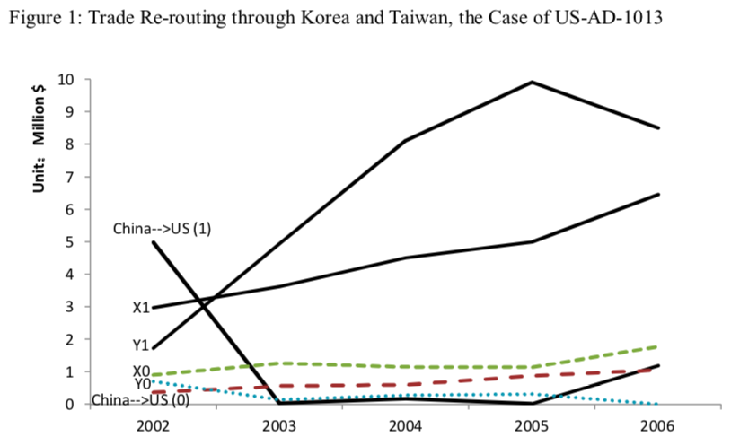
Notes:
https://www.google.com/url?sa=t&rct=j&q=&esrc=s&source=web&cd=5&ved=0ahUKEwil_cGcqOfbAhWMr4MKHeCCDtoQFghOMAQ&url=http%3A%2F%2Fwww.freit.org%2FWorkingPapers%2FPapers%2FTradePatterns%2FFREIT1124.pdf&usg=AOvVaw2TAxNCeF9uvMUCU2YeblHc

Slide 14
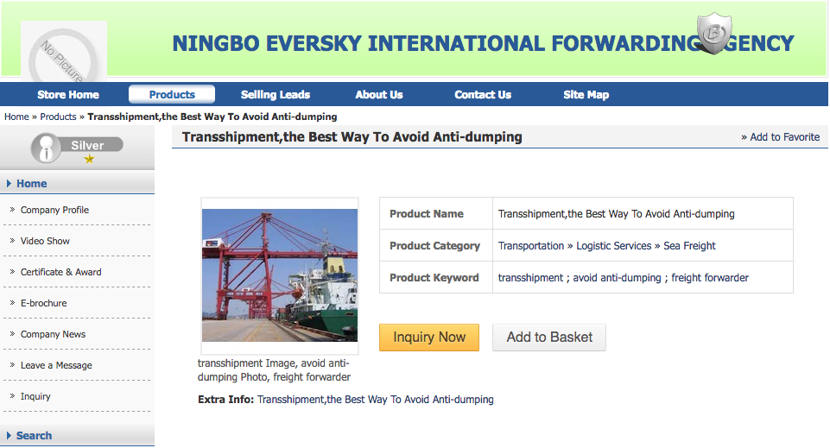
Notes:
http://reexport.en.busytrade.com/products/info/1796943/Transshipment-the-Best-Way-To-Avoid-Anti-dumping.html

Slide 15
Circumvention Examples
Mattress innersprings
2008: US ADD on China, S. Africa, and Vietnam
Producers shipped to Malaysia, then on to US

Slide 16
Circumvention Examples
Movement of production; more common in recent years
Solar panels
2012: US ADD on China
Production moved to Taiwan
2013: Threat of ADD on Taiwan
Production moved to Germany, South Korea, Singapore, and Malaysia
2018: US safeguard tariff on all imports

Slide 17
Circumvention Examples
Steel
US ADD on China
2017: US producers claim ADD circumvented by sending materials to Vietnam for processing and re-export

Slide 18
Circumvention Examples
Washing machines
2015: Whirlpool got ADD on Samsung and LG from S. Korea and Mexico
Companies moved production China
2018: US safeguard tariff on all imports

Slide 19
Economics of Circumvention
Effects of a tariff by Country A on some but not all countries:
(With or without dumping)
Exports from target countries to A fall
Exports from targets to other countries rise
Exports from other countries to Country A rise

Slide 20
Economics of Circumvention
These effects may, but need not, be by the same firm
If the importing country has high costs, this will always cause
Imports from lowest-cost country if permitted
Imports from other low-cost countries if not.
Is this “circumvention” or just trade?

Slide 21
How to Respond to ADD Circumvention
The policy community would probably say
Better monitor the true origins of imports
Economists would say
Don’t use tariffs at all, especially ADD
If domestic injury is the concern,
Use non-discriminatory, temporary safeguard tariffs
Or better: use other non-trade-distorting help for injured workers and industries

